Slide 1
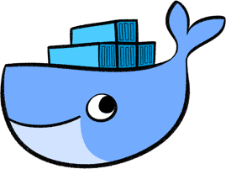
Introduction to Docker
Lesson 01: Introduction To Docker
Notes:
Add instructor notes here.

Slide 2
Lesson Objectives
In this lesson, you will learn:
What is Docker
Limitation of VM
Introduction to Container
Container Vs VM
Docker Architecture
Docker Community
Docker Installation(demo)
Notes:
What is Docker
Limitation of VM
Introduction to Container
Container Vs VM
Docker Community
Docker Architecture
Docker Installation(demo)
This lesson is to give an Introduction on Java Server Pages

Slide 3

1.1: What is Docker What is Docker ?
It is a Open source platform which was promoted by the company DotCloud.inc in 2013 October later on it was renamed to Docker Inc.
Notes:
Docker is open source, i.e., anyone can use it and can contribute to Docker to make it easier and more features in it which aren’t available in it.

Slide 4
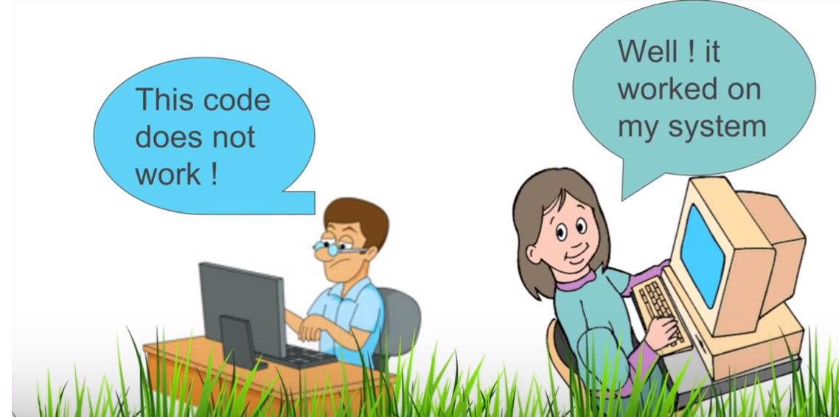
1.1: What is Docker Development / Production Environment
DEVELOPMENT ENVIRONMENT
It is a Open source platform
TESTING ENVIRONMENT
Notes:
The advantage of Docker platform is to ship, test, and deploy code quicker so that we can reduce the time between writing code and execute it in production.

Slide 5
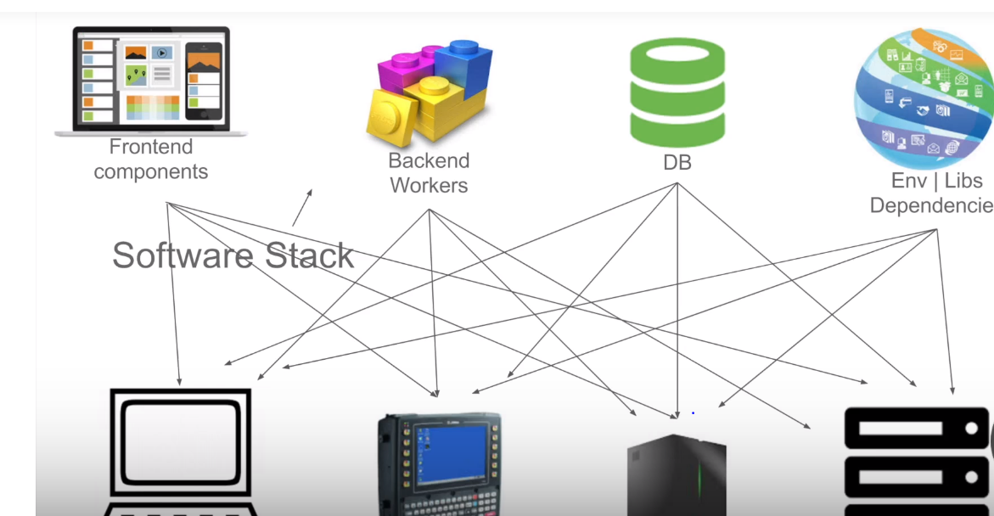
1.1: What is Docker Software Stack?
.
Notes:
Now a days The developer and the production people always try that , how the SW should run in every specific platform

Slide 6
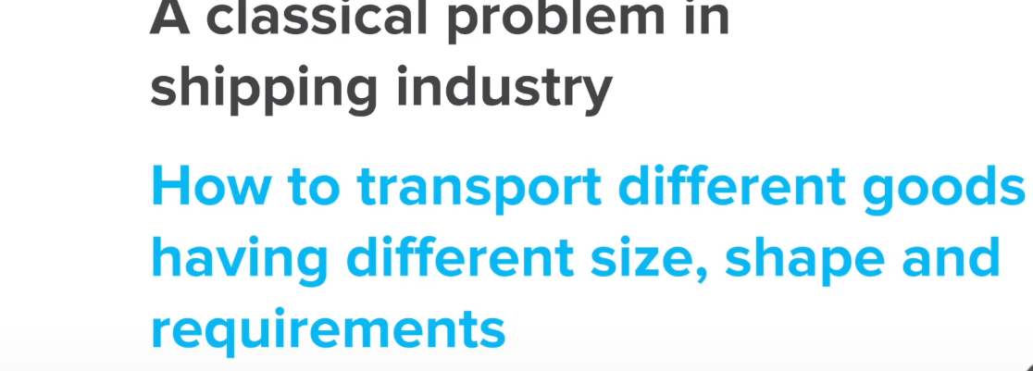
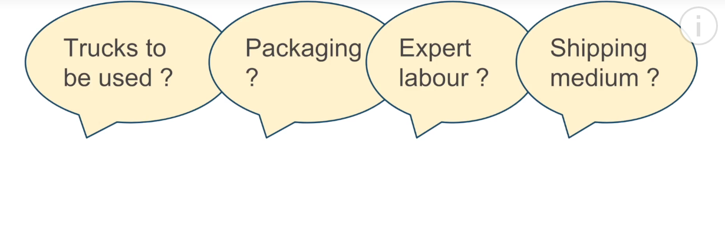
1.1: What is Docker Shipping Industry problem
.
Notes:
Now a days The developer and the production people always try that , how the SW should run in every specific platform

Slide 7
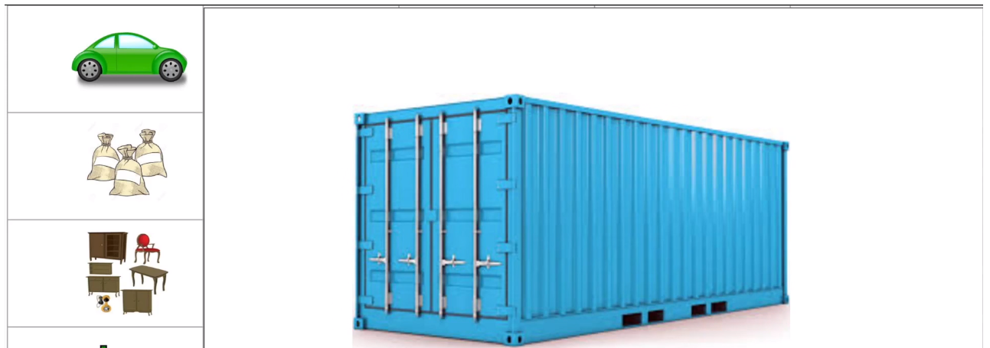
1.1: What is Docker Shipping Industry(Container is Sol…)
.
Notes:
Docker Container allows the developer to package up an application with all the parts it is required i.e. library and other dependencies
And ship it all into a one package.

Slide 8
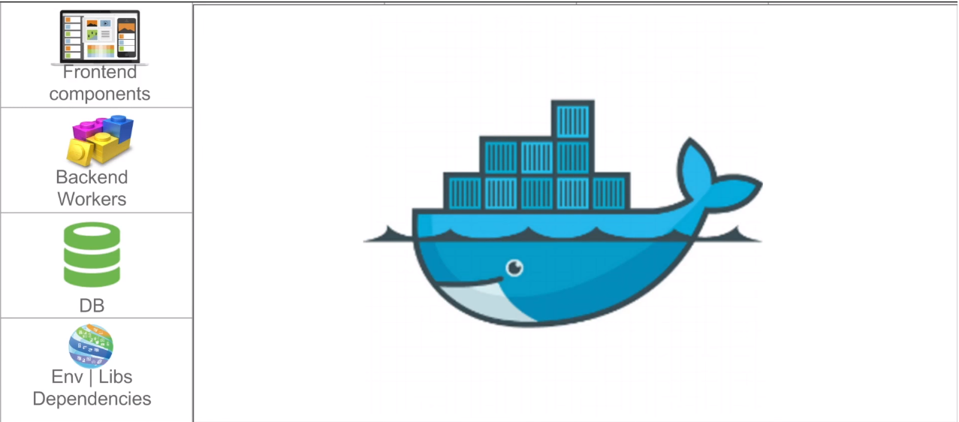
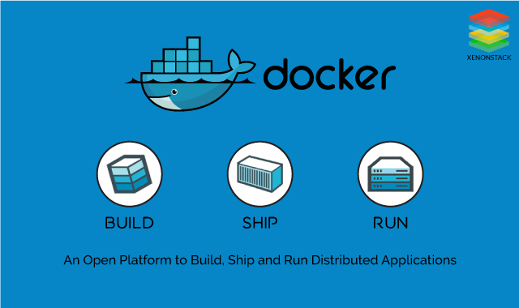
1.1: What is Docker Docker Provides Solution(S/W deploy)
.
Notes:
Docker Container allows the developer to package up an application with all the parts it is required i.e. library and other dependencies
And ship it all into a one package.

Slide 9
1.1: What is Docker Software Design Approach?
Design
Development
Deployment
Testing / Release
Notes:
Docker mainly use in Deployment stage. It makes the deployment process very easy , efficient .

Slide 10

1.1: What is Docker How Docker Works?
.
Notes:
Developer can create the application and package the SW into to Docker container and he will not worry about where and in which platform this package will be deployed. The complete deployment will be taken care by Docker.

Slide 11
1.1: What is Docker What is Docker ?
Docker Containers allow us to separate the applications from the infrastructure so we can deploy application/software faster.
Docker Container have many components
Docker Swarm
Docker Compose
Docker Images
Docker Daemon
Docker Engine.
Kitematic
The Docker is like a virtual machine but instead of creating a new whole virtual machine, it allows us to use the same Linux kernel.
Notes:
We can manage our infrastructure in the same ways as we manage our applications. The Docker is like a virtual machine but creating a new whole virtual machine; it allows us to use the same Linux kernel.

Slide 12
1.2:Limitation of VM Limitation of VM(Virtualization)
Each VM still require
CPU Allocation
Storage
RAM
Entire Guest O/S
Notes:
Hypervisor – It is a SW which helps to create multiple VM s on a Host OS.
Each VM has it’s own O/S and it doesn’t use the Host Operating System(O/S)
It could be a overhead for Host platform
We also need to provide a separate Space , RAM for Each VM , which is a lot of wastage of Memory and space
Guest Operating System :- It means more wasted resources
Application Portability also not sure

Slide 13
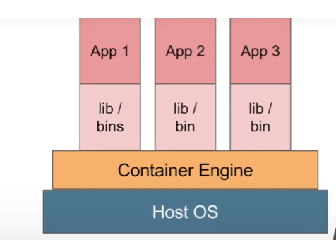
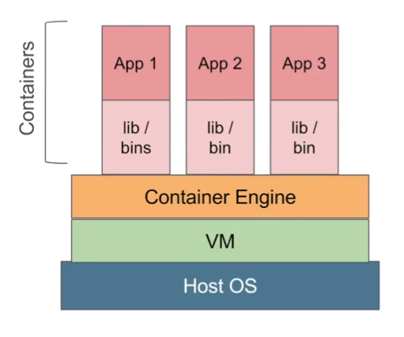
1.3: Introduction to container Introduction to Container(Containerization)
Notes:
Here no Hypervisor but Container Engine is there and In App , there is no guest O/S but dependency of App are there.
Here there are no wastage of memory and the load on Host O/S is less .
In some scenario where we work on Window O/S and launching a Linux Machine on Window platform , VM is required

Slide 14
1.3: Introduction to container Introduction to Container(Containerization)
Each those Container has it’s own
Root File system
Processes
Memory
Devices
Network port etc.
Notes:
Each those Guest instances are called as Container
Each those Container has it’s own
Root File system
Processes
Memory
Devices
Network port etc.

Slide 15
1.4:Container Vs VM Container Vs VM
Container is light weight then VM
In Container , no need to install Guest Operating System
Container consumes less CPU , RAM , Storage space
One can Use more Container as compare to VM.

Slide 16
1.4:Container Vs VM Container Vs VM
Container is the best choice for Microservices
Notes:
As per the requirement Container consume memory , RAM

Slide 17
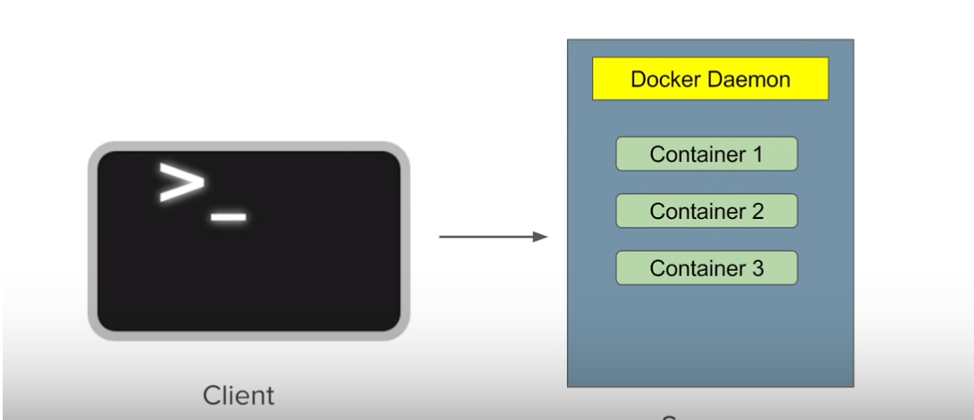
1.5:Docker Architecture Docker Architecture
Docker follows the Client – Server Architecture
Docker Server receives the Client request from a Command line or through Rest Service API.
Docker Client and Server may be located in Same Host or in a different Host machine
Server
Server
Notes:
Docker Client : It could be a Command line Prompt

Slide 18
1.5:Docker Architecture Docker Architecture
All the components of Docker Client and Server together forms the Docker Engine .
Docker Engine
Notes:
The Docker Daemon Server receives the commands from Docker Client through CLI or REST API,s. and builds , run and distributed the container
Docker Client and Server may be located in Same Host or in a different Host machine
Docker client may be CLI client or in GUI(Kitematic)

Slide 19
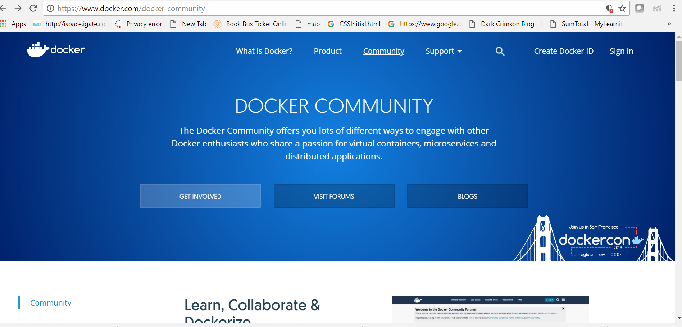
1.6:Docker Community Docker Community(CE) Edition
Notes:
Docker Community Edition (CE) is ideal for developers and small teams looking to get started with Docker and experimenting with container-based apps. Available for many popular infrastructure platforms like desktop, cloud and open source operating systems, Docker CE provides an installer for a simple and quick install .... so you can start developing immediately. Docker CE is integrated and optimized to the infrastructure so you can maintain a native app experience while getting started with Docker.

Slide 20
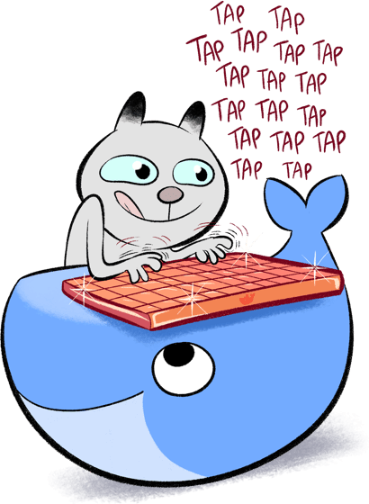
1.6:Docker Community Docker Community(CE) Features
The latest Docker version with integrated tooling to build, test and run container apps
Available for free with software maintenance for
the latest shipping version
Integrated and optimized for developer
desktops, Linux servers and clouds.
Monthly Edge and quarterly Stable release
channels available
Notes:
Docker Community Edition (CE) is ideal for developers and small teams looking to get started with Docker and experimenting with container-based apps. Available for many popular infrastructure platforms like desktop, cloud and open source operating systems, Docker CE provides an installer for a simple and quick install .... so you can start developing immediately. Docker CE is integrated and optimized to the infrastructure so you can maintain a native app experience while getting started with Docker.

Slide 21
1.6:Docker Community Docker Community(CE) Features
Native desktop or cloud provider experience for
easy onboarding
Unlimited public and one free private repo
storage as a service
Automated builds as a service
Image scanning and continuous vulnerability
monitoring as a service
Notes:
Docker Community Edition (CE) is ideal for developers and small teams looking to get started with Docker and experimenting with container-based apps. Available for many popular infrastructure platforms like desktop, cloud and open source operating systems, Docker CE provides an installer for a simple and quick install .... so you can start developing immediately. Docker CE is integrated and optimized to the infrastructure so you can maintain a native app experience while getting started with Docker.

Slide 22
1.7: Docker installation Demo
Demo on:
Docker Installation( Steps given in Note section)
Notes:
Step 1 : Go To your EC2 instance and note the public IP address
Step 2: In your Window platform Use the puttygen and putty.exe files to connect to your Linux server instance in AWS .
Type the command to install Docker
Step 3 : sudo yum update –y
Step 4: sudo yum install -y docker
Check the Docker is successfully installed or not
Step 5 : Type the command “docker -v”
Type the command to Start the Docker service
Step 6: sudo service docker start
Now Add the EC2 user to your Docker group . Type the command
Step 7: sudo usermod -a -G docker ec2-user
Step 8 : Now type the command “Docker info”
Below Command for Stop the Docker
Step 8 : sudo service docker stop
To uninstall the docker . Type the below command
Step 9 : sudo yum remove docker

Slide 23
Summary
In this lesson, you have learnt:
Introduction to Docker
How Docker provides Solution in SW or Application implemented
Limitation of VM
What is Containerization
The Differences between VM and Container
Docker Architecture
Docker community

Slide 24
Review – Questions
Question 1: Docker container is light weight then VM.
Option 1 : True
Option 2 : False
Question 2 : _________ requires a Guest O/S and need Space , RAM , storage capacity.
Notes:
Answers for the Review Questions:
Answer 1: True
Answer 2: VM

